Slide 1
1.Write Amplification: Garbage collection
NAND flash memory - non-volatile memory (ex. SSD)
A log structured system
Written in a unit of page: 4KB
Erased in a unit of a block: 512KB (bigger than the unit of write)
Does not support in-place update
Internal fragmentation and tidy the fragmented data for GC
Moves valid pages from one place to another for GC
This makes additional writes (W.A)
Dependent for
1. space utilization: SSD is nearly full, GC initiates quicker but less efficient
Still a larger fraction of the blocks(invalid blocks) are still alive
2. hotness of data: hot data tends to be more frequently invalidated, GC is efficient when hot workload concentrates on a small portion of data

Slide 2
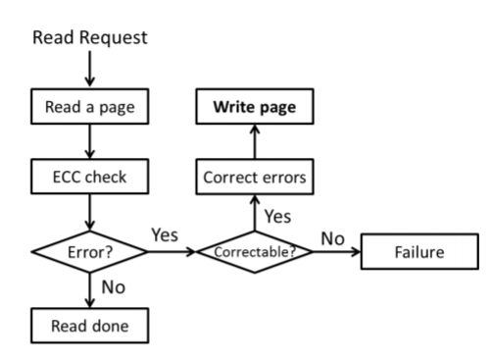
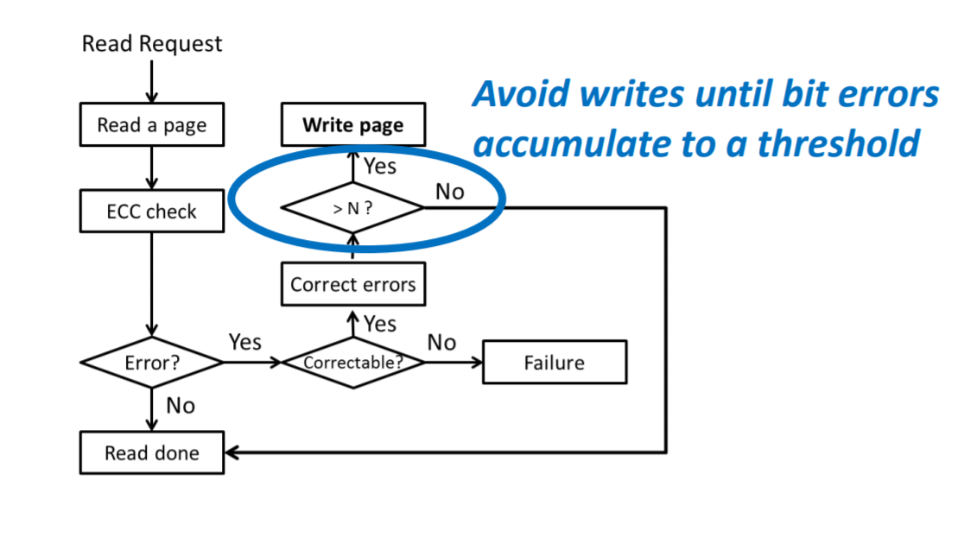
TECC
2. Write Amplification: ECC recovery
ECC: Error Correcting Code
W.A. due to ECC recovery
Reads lead to write
(Write amplification due to ECC on flash memory or leave those bit errors alone, MSST’12 )

Slide 3


Today 공부한 내용
Mean Time to Data Loss(MTTDL)
Mean Time to Data Loss(MTTDL):the mean time to data loss, the expected time to encounter the first data loss, 길면 길수록 Endurance 높다.
The data loss rate for single SSD
State(j)에서 data loss가 발생할 확률
State(1~j-1)까지 data loss가 발생하지 않을 확률
Time to write whole system once
Us : space utilization of SSD
T : the number of pages in an SSD
v(x) : uncorrectable page error rate

Slide 4
A Markov model of RAID5 system
The data loss rate for reaching state FR(data loss: RAID cannot recover the system )
Uncorrectable page error rate
1+3 = (N-1)(v(x)+d)
NusTv(x)
v0
Data loss
Parity protection loses data when
1.Two Page errors in the same page group
2.Two device failures
3.Page error + device failure
4.Device failure + page error
FR
0
2+4=(N-1)(usTv(x)+d)
1
d0
Nd
n
Device failure rate
Device recovery rate

Slide 5
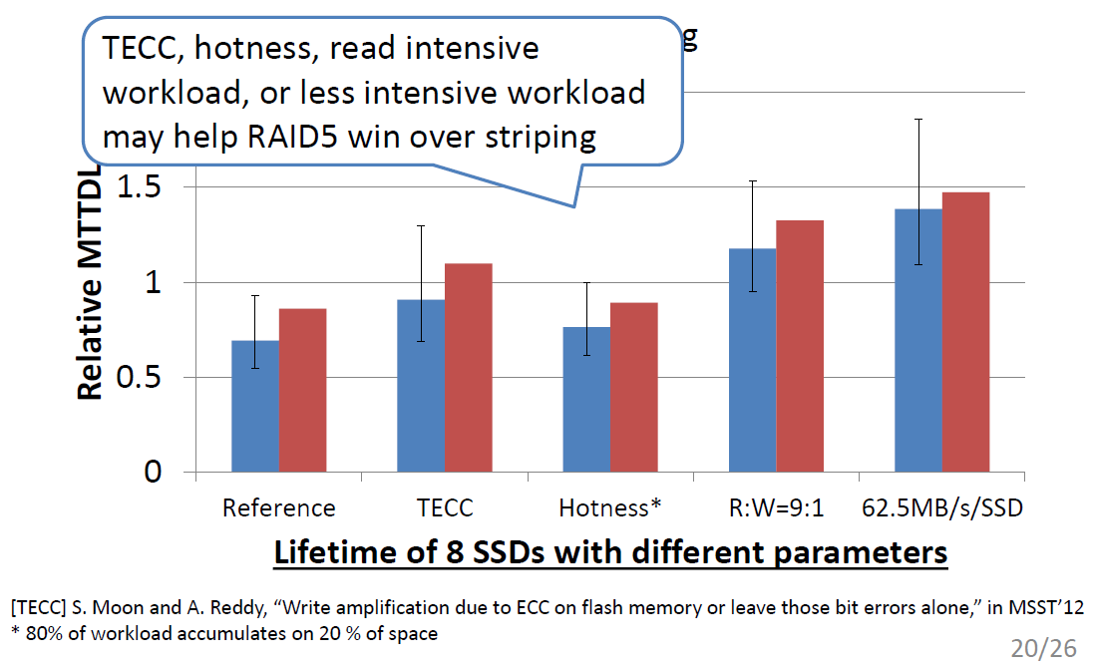
Today 공부한 내용
Different Parameters
*8 SSD Capacity= 640GB

Slide 6
Different Parameters
TECC(Threshold ECC)
ECC overhead 감소, parity overhead영향 증가
Hotness: slightly increase the W.A. (80% data in 20% of space)
GC efficient , GC overhead 감소
Slightly
Read-intensive workload
Less write, but ECC로 인한 overhead가 62.5MB/s/SSD보다 크다
Less-intensive workload
More writes but lower read bandwidth, converts to redundant writes from frequent ECC recovery( read -> ECC로 error체크 -> write)
*8 SSD Capacity= 640GB

